Slide 1
Digital Portfolio
STUDENT NAME:John Benittan V
REGISTER NO AND NMID: 2428C0479,
E205A824D86DC828D6940DDC2DA85331
DEPARTMENT: Bsc AI & ML
COLLEGE: KPR College of Arts & Science, Bharathiar University

Slide 2
PROJECT TITLE
Educational Consultant Portfolio Website

Slide 3


AGENDA
Problem Statement
Project Overview
End Users
Tools and Technologies
Portfolio design and Layout
Features and Functionality
Results and Screenshots
Conclusion
Github Link
3/21/2024 Annual Review

Slide 4

PROBLEM STATEMENT
Students often struggle to choose the right academic path, scholarships, or skill-building opportunities. Traditional guidance methods (word-of-mouth, posters, informal sessions) lack structure and reliability.
A digital portfolio allows an educational consultant to present expertise, achievements, and services in an organized way, ensuring visibility, trust, and easy communication with students, parents, and institutions.

Slide 5

PROJECT OVERVIEW
The Educational Consultant Portfolio website highlights academic guidance skills, showcases achievements, and provides easy access for students, parents, and institutions.
It acts as a professional platform to present expertise, improve trust, and attract future opportunities by offering structured information about services and educational support.

Slide 6

WHO ARE THE END USERS?
- Students
- Parents
- Educational Institutions
- Sponsors & NGOs
- Career Counselors / Mentors

Slide 7

TOOLS AND TECHNIQUES
- HTML5
- CSS3 (3D Effects, Gradients)
- JavaScript (Interactivity)
- GitHub Pages (Deployment)
- VS Code (Development)

Slide 8
POTFOLIO DESIGN AND LAYOUT
Modern, Clean Layout with structured sections for smooth readability
Sections Included: Home, About Organizer, Events Showcase, Achievements, Contact
Event-Themed Colors: Gold (highlights, headings) & Dark Blue (backgrounds, buttons)
Interactive 3D Hover Effects on event/project cards to make showcases engaging
Sticky Navigation Bar for smooth scrolling across sections
8

Slide 9
FEATURES AND FUNCTIONALITY
- Event showcase with highlights
- Interactive 3D hover cards
- Responsive and mobile-friendly layout
- Sticky navigation with smooth scrolling
- Contact form and collaboration links

Slide 10
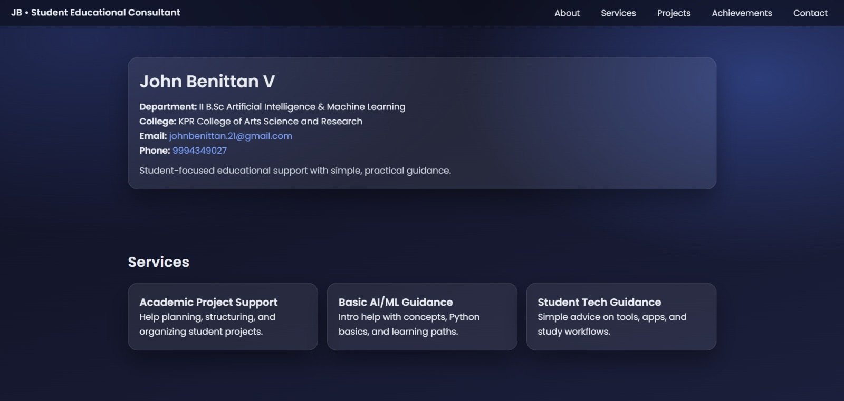

RESULTS AND SCREENSHOTS
Results:
Improved academic guidance access
Enhanced student–consultant communication
Increased trust and visibility
Screenshot:
3/21/2024 Annual Review
10

Slide 11
CONCLUSION
The Educational Consultant Portfolio provides a professional platform to showcase expertise, guidance skills, and achievements in academic consulting.
It builds trust, enhances visibility, and creates opportunities for student support and institutional collaboration.
Future Scope:
Adding student success stories and testimonials
Integration with social media (LinkedIn, YouTube)
AI-based counseling and recommendation features
11

Slide 12
Git hub Link: Portfolio Repository: https://github.com/john-benittan/portfolio.git

